Slide 1


CHURN PREDICTION
for Telecom Companies
Notes:
Customer churn, also known as customer attrition, occurs when customers stop doing business with a company.
https://www.kaggle.com/meldadede/churn-prediction-of-telco-customers
https://www.kaggle.com/dileep070/logisticregression-telecomcustomer-churmprediction#internet_data.csv
https://medium.com/@rohitlal/customer-churn-prediction-model-using-logistic-regression-490525a78074
https://blogs.rstudio.com/tensorflow/posts/2018-01-11-keras-customer-churn/
https://www.kdnuggets.com/2019/05/churn-prediction-machine-learning.html

Slide 2
OBJECTIVE /
STATEMENT PROBLEM

Slide 3

OBJECTIVE / STATEMENT PROBLEM
To achieve company goals in Growth by both acquiring new clients and retain existing ones
Notes:
The telecommunication market is one of the toughest markets as customers are always free to choose from plenty of providers even within one product category. If companies in this market wanted to achieve their goals in growth, they cannot only do it by acquiring new clients as a very important part of the growth comes from the existing clients.

Slide 4


OBJECTIVE / STATEMENT PROBLEM
Acquiring new clients is 5 times more expensive than retaining existing clients
Notes:
Acquiring a new client costs 5 times as much as retaining an existing one. This is not to say that the companies shouldn’t go out and get new customers, but if they can also keep them for a longer life cycle, their revenue foundation will be both more profitable and predictable. Statistics by Bain & Company about customer retention: Increasing customer retention rates by just 5% increases profits by 25% to 95%
Another statistics, this time bad news: According to a Bain & Company study, 60-80% of customers who describe themselves as satisfied do not go back to do more business with the company that initially satisfied them. So, companies have to find a way to predict customer behavior and retain them.

Slide 5
EXPECTED OUTCOME
OF ANALYSIS

Slide 6


EXPECTED OUTCOME OF ANALYSIS
Ability to monitor customers and review customer-retaining strategies
Categorized customers churn
Notes:
Ability to forecast rate of customer attrition. This allows the company to target the individual customer and come up with retaining strategy which could also be customized to further prevent them from leaving.
Ability to categorize churn customer into groups. This way, the company can easily find the right products and services to retain the customers more effectively.

Slide 7
DATA SOURCES

Slide 8




DATA SOURCES
The data set is from IBM Sample Data Sets which includes:
Customer Churn
Subscription
Information
Payment Information
Demographic Information
Notes:
Churn: Customers who left within the previous month
Services customer has signed up: phone, multiple lines, internet, online security, online backup, device protection, tech support, streaming TV, movies
Customer account information: contract, payment method, paperless billing, monthly charges, total charges
Demographic info: gender, age range, single or married

Slide 9
BUSINESS VALUE /
BENEFITS

Slide 10



BUSINESS VALUE / BENEFITS
Loyalty
Revenue
Advantage
Notes:
Increase Customer Loyalty
More income without increasing investment by much
Gaining a competitive advantage
เอาไปใช้ได้>>Predicting churn rates can also help your business identify and improve upon areas where customer service is lacking. And, by making those improvements, you can decrease churn and improve revenue numbers.

Slide 11
IMPLEMENTATION

Slide 12
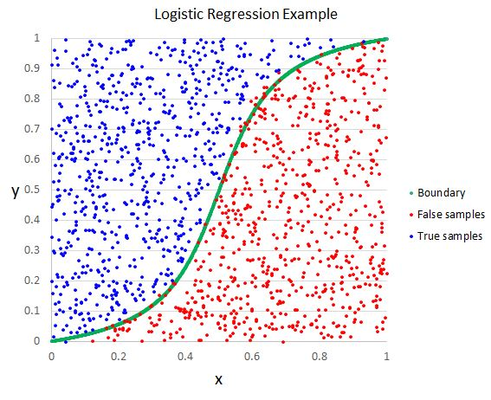
IMPLEMENTATION
Notes:
Since the problem is a binary classification problem, so we will use logistic regression as the base model.
Logistic regression predicts the likelihood of an event by measuring the relationship between a dependent variable and the features.

Slide 13
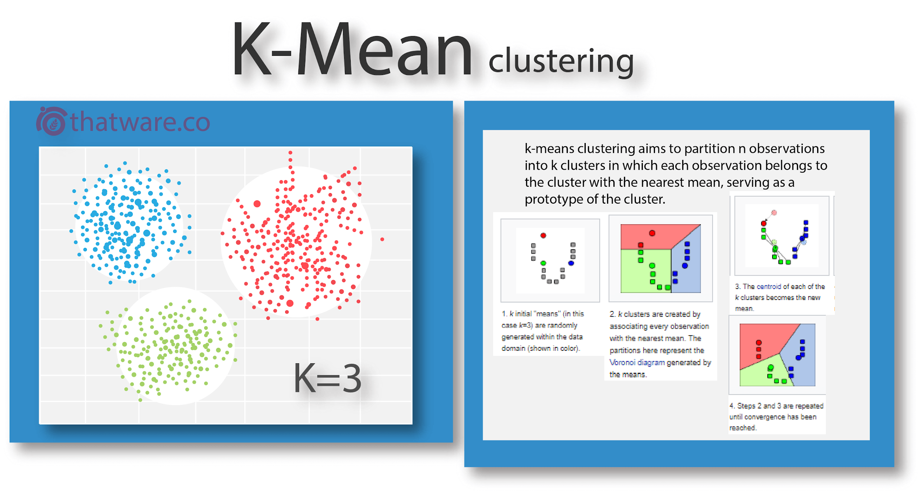
IMPLEMENTATION
Notes:
After we predict the likely churn customer, we’ll try to categorize them into group by K-mean clustering. From the k-mean result, we’ll analyze the characteristic of each group which can be determine for the promotion to retain the customer.

